Slide 1
Nitrogen Purging
To test oxygen leakage into the system, a test solution of FIrpic was prepared in the glove box and loaded into the measurement setup (~1mM)
LED is only turned on to acquire data points and the solution is otherwise kept in the dark
Points taken in rapid succession seem to show warmup of the LED
Nitrogen purge dramatically reduces oxygen quenching during test
Still see loss, two possible sources
Trapped oxygen from when we transport to the test apparatus
Purity of house nitrogen
Plateau suggests this is not a continuous leak of high oxygen source

Slide 2
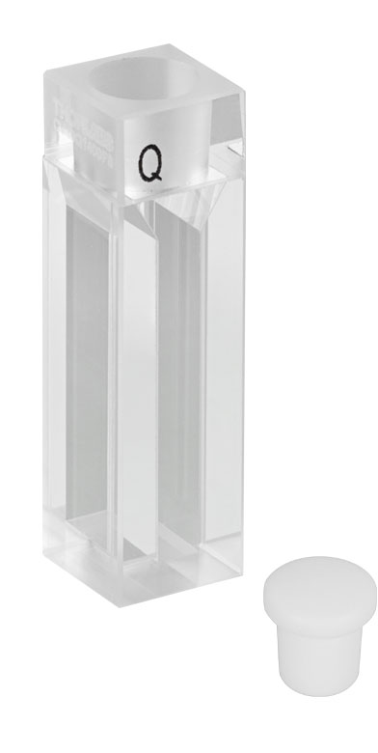
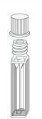
Cuvette Options
Either problem may be further reduced by threading the lid
We currently have the stoppered cuvette from Thorlabs ($84)
Quartz, optical path length of 4 mm
Starna sells 2 cuvettes of interest
Special optical glass (good to 320 nm), 4 mm path ($165)
Quartz, 2 mm path ($275)

Slide 3
Absorptivity
Jack has measured absorptivity as a function of concentration
200 uM saturates the UV/VIS
Based off of this, the intensity profile of the cuvette is shown
We think that the 2 mm path length would be better, but for the concentrations we are interested in, the 4 mm cheaper cuvette would be sufficient

